Slide 1
Computer Organization
CS1403
System Performance

Slide 2
Performance
Performance is the key to :
understanding underlying motivation for the hardware
and its organization
Measure, report, and summarize performance to enable users to
make intelligent choices
see through the marketing hype!
Why is some hardware better than others for different programs?
What factors of system performance are hardware related? (e.g., do we need a new machine, or a new operating system?)
How does the machine's instruction set affect performance?

Slide 3
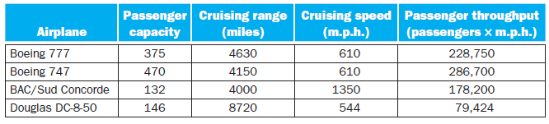
Define performance: How?
How much faster is the Concorde compared to the 747?
How much bigger is the Boeing 747 than the Douglas DC-8?
So which of these airplanes has the best performance?

Slide 4
Computer Performance
Response Time (elapsed time, latency):
how long does it take for my job to run?
how long does it take to execute (start to
finish) my job?
how long must I wait for the database query?
Throughput:
how many jobs can the machine run at once?
what is the average execution rate?
how much work is getting done?
If we upgrade a machine with a faster processor?
If we add additional processor to the system?
Individual user
concerns…
Systems manager
concerns…
Notes:
Have them raise their hands when answering questions

Slide 5
Execution Time
Elapsed Time
counts everything (disk and memory accesses, waiting for I/O, running other programs, etc.) from start to finish
a useful number, but often not good for comparison purposes
elapsed time = CPU time + wait time (I/O, other programs, etc.)
CPU time
doesn't count waiting for I/O or time spent running other programs
can be divided into user CPU time and system CPU time (OS calls)
CPU time = user CPU time + system CPU time
⇒ elapsed time = user CPU time + system CPU time + wait time
Our focus: user CPU time (CPU execution time or, simply, execution time)
time spent executing the lines of code that are in our program

Slide 6



Definition of Performance
For some program running on machine X:
X is n times faster than Y means:
Means:

Slide 7
Relative Performance
If computer A runs a program in 10 seconds and computer B runs the same program in 15 seconds, how much faster is A than B?

Slide 8
Clock Cycles
Instead of reporting execution time in seconds, we often use cycles.
In modern computers hardware events progress cycle by cycle: in other words, each event, e.g., multiplication, addition, etc., is a sequence of cycles
Clock ticks indicate start and end of cycles:
time
cycle

Slide 9
Clock Cycles
cycle time = time between ticks = seconds per cycle
clock rate (frequency) = cycles per second (1 Hz. = 1 cycle/sec, 1 MHz. = 10⁶ cycles/sec)
Example: A 200 Mhz. clock has a cycle time:

Slide 10


Performance Equation I
Alternatively
So, to improve performance one can either:
reduce the number of cycles for a program, or
reduce the clock cycle time, or, equivalently,
increase the clock rate

Slide 11
Check Yourself
Our favorite program runs in 10 seconds on computer A, which has a 400Mhz. clock.
We are trying to help a computer designer build a new machine B, that will run this program in 6 seconds. The designer can use new (or perhaps more expensive) technology to substantially increase the clock rate, but has informed us that this increase will affect the rest of the CPU design, causing machine B to require 1.2 times as many clock cycles as machine A for the same program.
What clock rate should we tell the designer to target?

Slide 12
How many cycles are required for a program?
Could assume that # of cycles = # of instructions
1st instruction
2nd instruction
3rd instruction
4th
5th
6th
...
time
This assumption is incorrect! Because:
Different instructions take different amounts of time (cycles)
Why… ? More on it later.

Slide 13

Performance Equation II
The term clock cycles per instruction, which is the average number of clock cycles each instruction takes to execute, is often abbreviated as CPI
Different instructions may take different amounts of time depending on what they do
CPI is an average of all the instructions executed in the program.
CPI provides
one way of comparing two different implementations of the same instruction set architecture
since the number of instructions executed for a program will, of course, be the same.

Slide 14

Classic CPU Performance Equation
OR

Slide 15
CPI Example I
Suppose we have two implementations of the same instruction set architecture (ISA). For some program:
machine A has a clock cycle time of 10 ns. and a CPI of 2.0
machine B has a clock cycle time of 20 ns. and a CPI of 1.2
Which machine is faster for this program, and by how much?

Slide 16
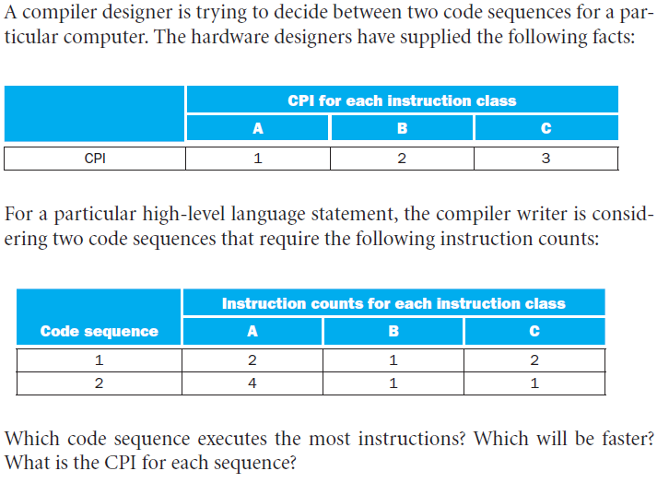
CPI Example II

Slide 17
To summarize:
The only complete and reliable measure of computer performance is time.
Changing the instruction set to lower the instruction count may lead to
an organization with a slower clock cycle time or higher CPI that offsets the improvement in instruction count.
Similarly, because CPI depends on type of instructions executed, the code that executes the fewest number of instructions may not be the fastest.

Slide 18
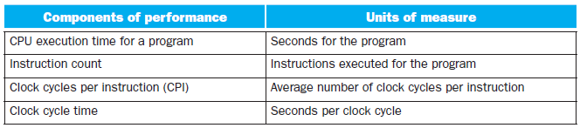
Components of Performance
We can measure the CPU execution time by running the program
The clock cycle time is published as part of the documentation
The instruction count and CPI can be more difficult to obtain.
Of course, if we know the clock rate and CPU execution time
we need only one of the instruction count or the CPI to determine the other.

Slide 19
Components of Performance
Measure the instruction count by
using software tools
using a simulator of the architecture.
hardware counters, included in most processors, to record
the number of instructions executed,
the average CPI
Instruction count depends on the architecture, but not on the exact implementation
It can be measured
without knowing all the details of the implementation

Slide 20
Components of Performance
CPI depends on a wide variety of design details in the computer, including
both the memory system and the processor structure
the mix of instruction types executed in an application.

Slide 21
When Comparing Two Computers:
Must look at all three components, which combine to form execution time.
If some of the factors are identical
performance can be determined by comparing all the non-identical factors.
CPI varies by instruction mix
both instruction count and CPI must be compared, even if clock rates are identical.

Slide 22
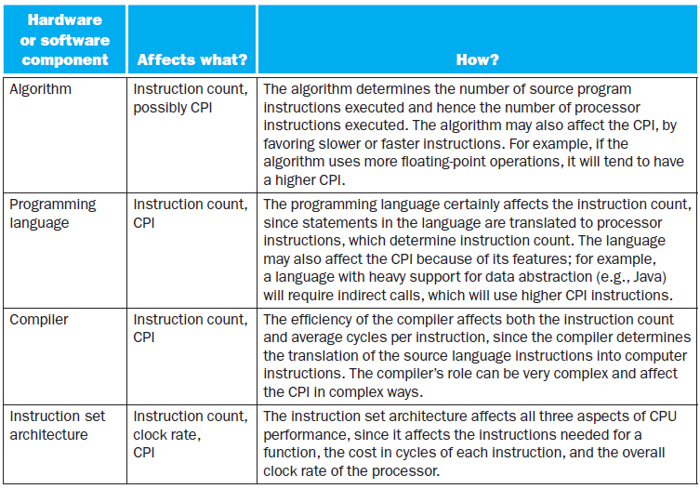
Understanding Program Performance

Slide 23
Some Last Words:
You might expect that the minimum CPI is 1.0
Modern processors fetch and execute multiple instructions per clock cycle. (More Later)
If a processor executes
on average 2 instructions per clock cycle, then it has CPI of 0.5.

